Slide 1

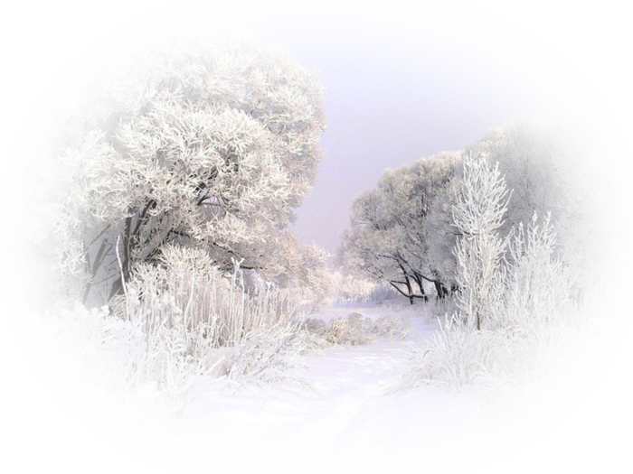

Topic: Nature and Weather
Everything is good in its season

Slide 2

Objectives:
by the end of the lesson pupils will be able:
to describe the weather using new lexical units and impersonal sentences;
to activate using of the modal verb “can”;
to work in pairs and groups.
to communicate with each other.
to develop listening, reading, speaking skills;

Slide 3

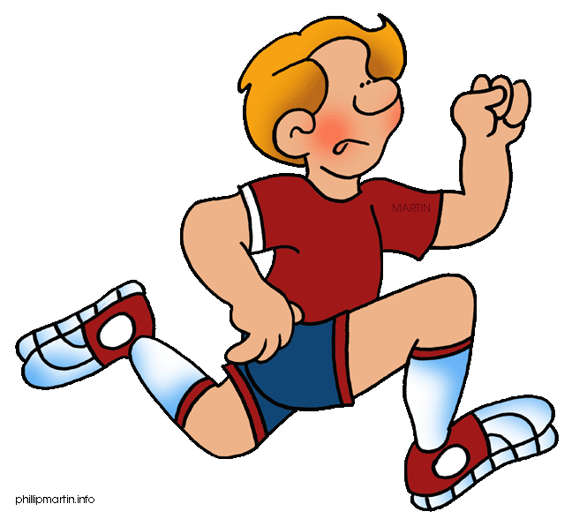
When you hear the sound, clap your hands.
Sound [Λ] :
I like to run
Out in the sun
It’s such a fun
To run, to run.

Slide 4
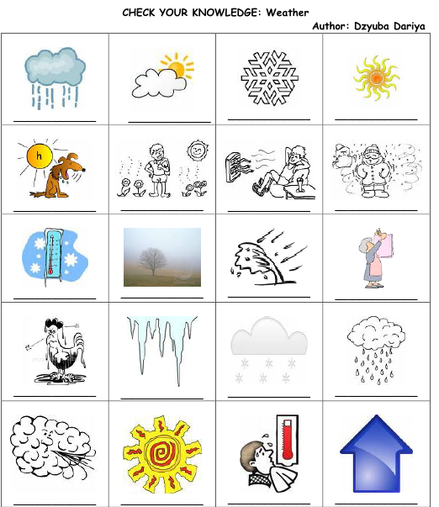

Slide 5
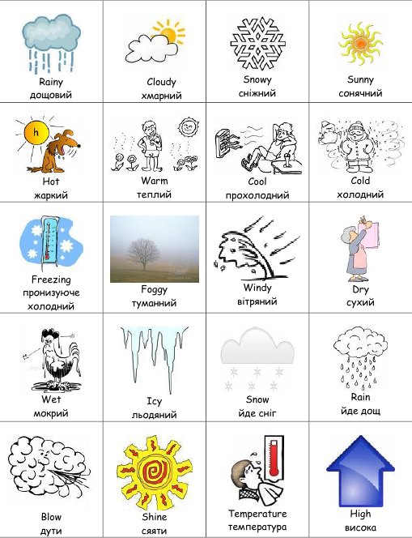

Slide 6
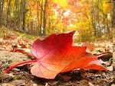



1. It’s cold and snowy. Christmas is in this season.
2. It’s hot and sunny. The sky is blue.
3. It’s rainy and wet. Trees and flowers are green.
4. It’s cold and cloudy. Trees are yellow and red.

Slide 7








WEATHER FORECAST
KIEV
UZHGOROD
+9
+27
DONETSK
-12
ODESA
+15
What is the weather like in ……….?
What is the temperature in ……….?

Slide 8

SONG

Slide 9


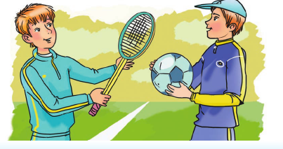
Winter sports
What kinds of sports do you know?
Summer sports

Slide 10



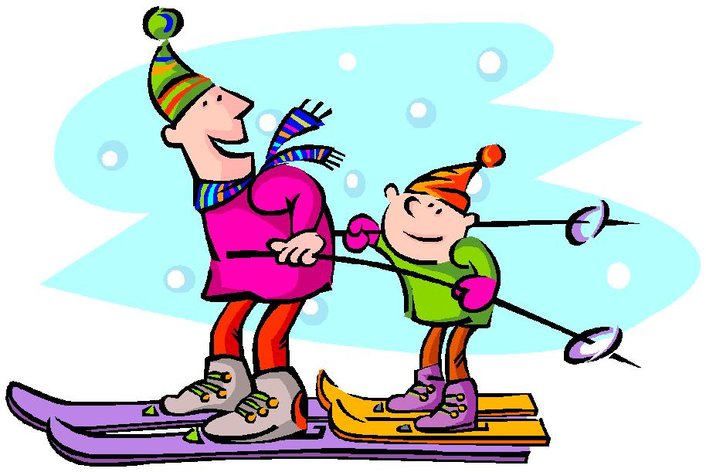
Look at the picture and match the words
FOOTBALL
HOCKEY
CYCLING
SKIING
RUNNING
e. g: I can run in summer.

Slide 11
Break

Slide 12

Use the plan and the prompts to describe seasons
Plan
Say what is your favourite season;
Describe the weather and nature;
Say what can you do at this season.
Use the prompts:
Favourite season – beautiful, fantastic;
Weather and nature – sunny, rainy, snowy;
Activities – to swim, to ski, to play tennis.

Slide 13

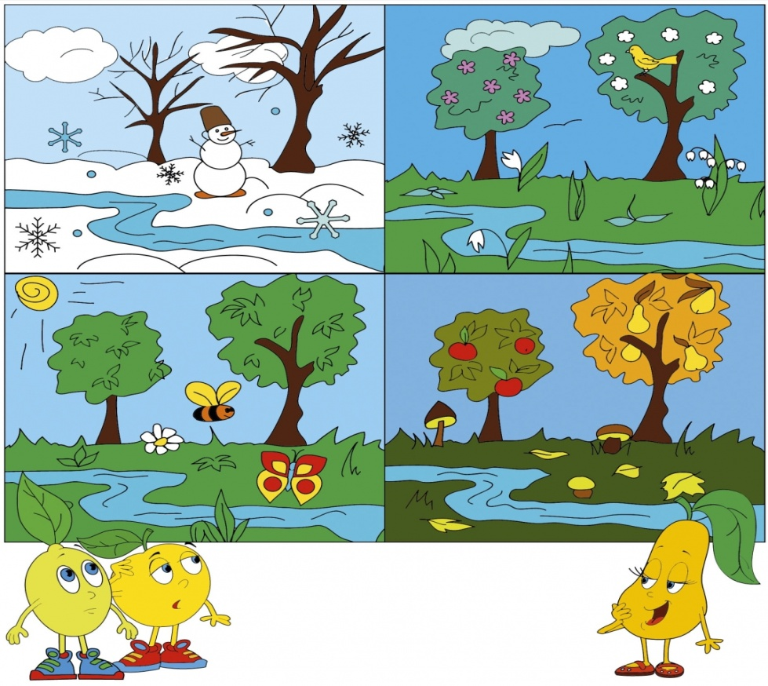

Home task
Write about your favourite season.
My favourite season is… .
I think that… .
I can play... .
I like … because… .

Slide 14
Goodbye!

