Slide 1
Famous places of London

Slide 2
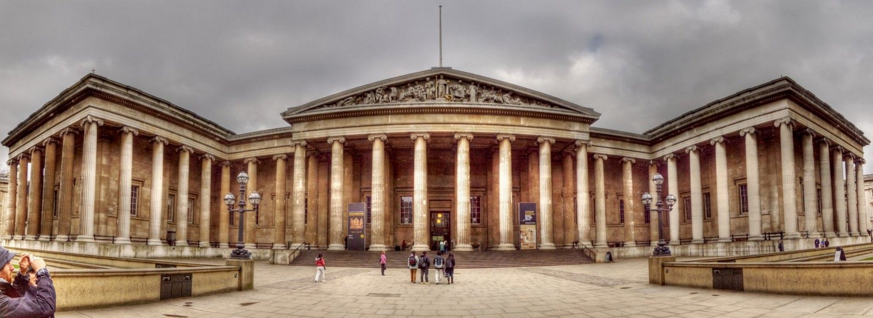
The British Museum
You can find collections of art, literature, and other artefacts telling the story of human history. You’ll find separate wings for Ancient Egypt, Ancient Greece and Rome, Asia, Europe, the Middle East, and the Americas, spread across three floors.

Slide 3
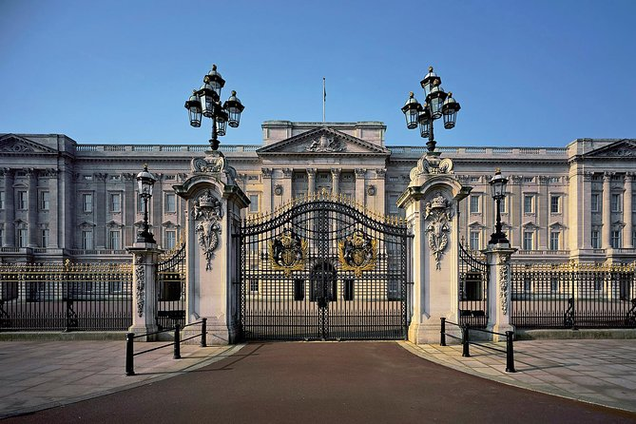
Buckingham Palace
Buckingham Palace has been the London home of the British king or queen since 1837. It is used by Queen Elizabeth II as her official residence, or place to stay. The queen and her family live in the palace.

Slide 4
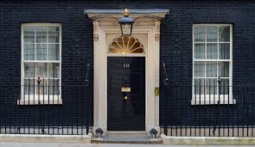
Downing Street
Is the address of the London residence and office of the Prime Minister of the United Kingdom. The residence was presented by George II in 1733 to Robert Walpole, the first official Prime Minister of the country.

Slide 5
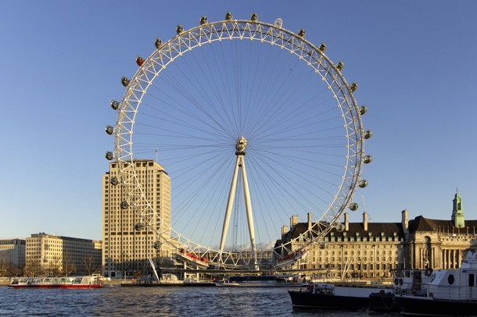
London Eye
Is a large metal Ferris wheel. It is also known as the Millennium Wheel and is one of the largest observation wheels in the world.

Slide 6
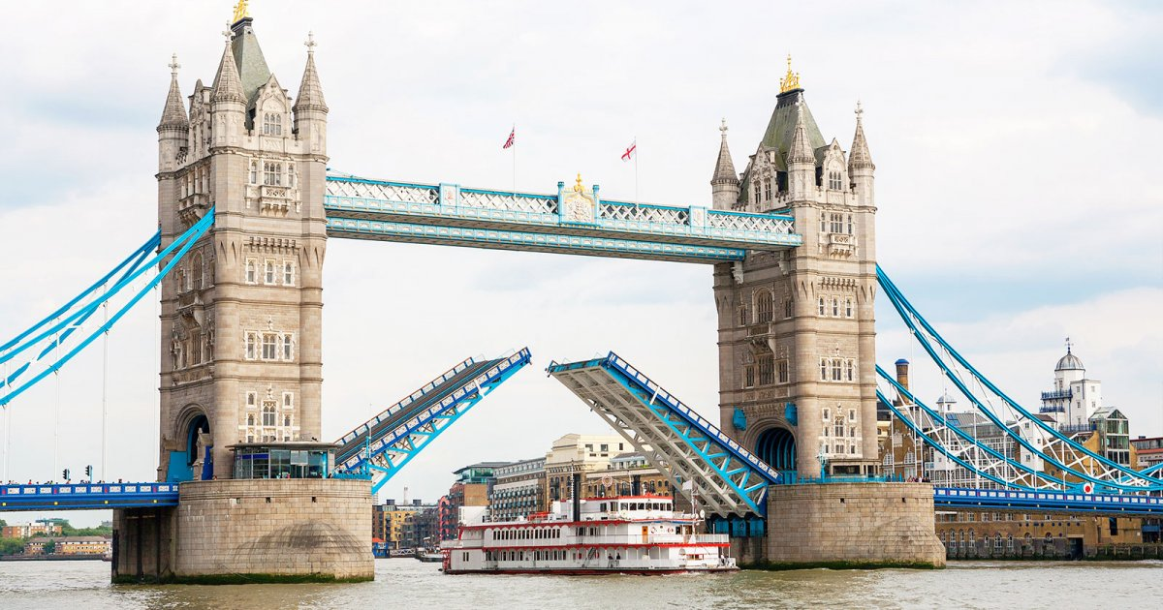
Tower Bridge
It crosses the River Thames near the Tower of London. It is a drawbridge (розвідний міст), which allows ships through the bridge deck when the deck is raised in the centre at an angle.

Slide 7
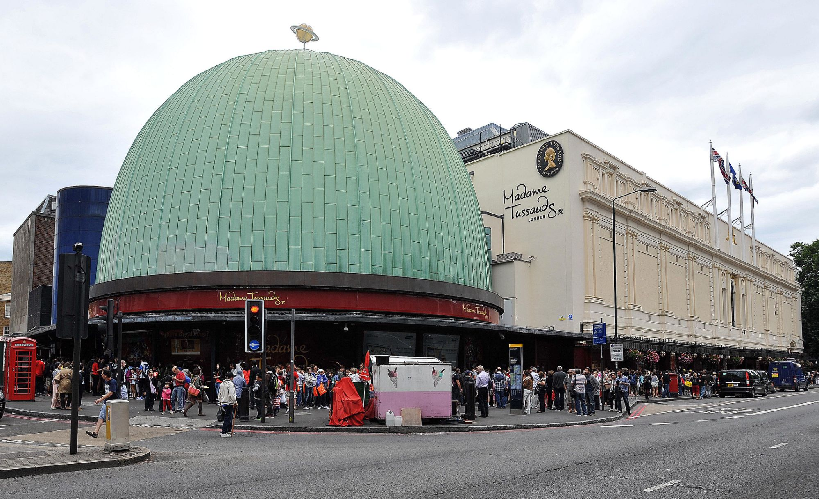
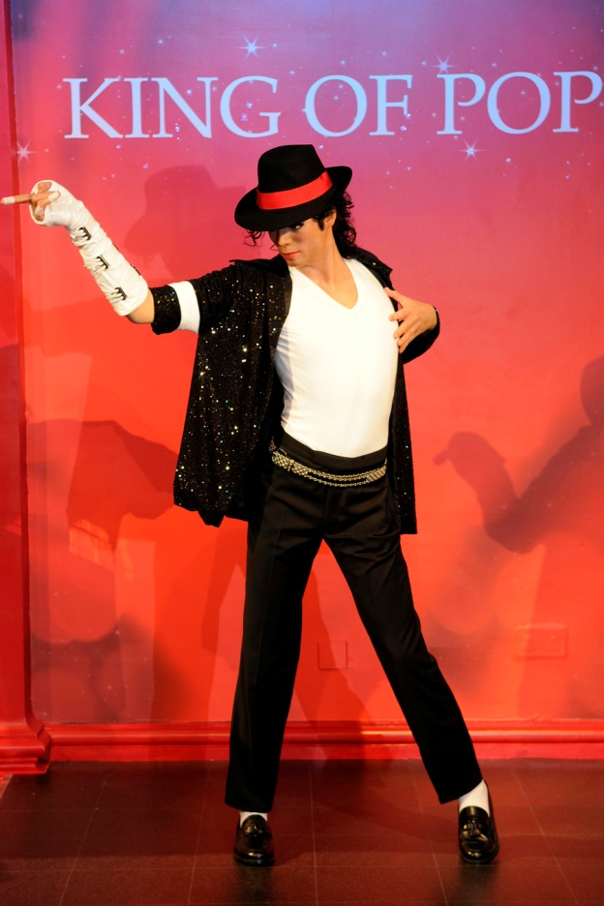
Madame Tussauds
is a wax museum in London displaying the waxworks of famous and historic people and also popular film characters. It used to be known as "Madame Tussaud's“; the apostrophe is no longer used.

Slide 8
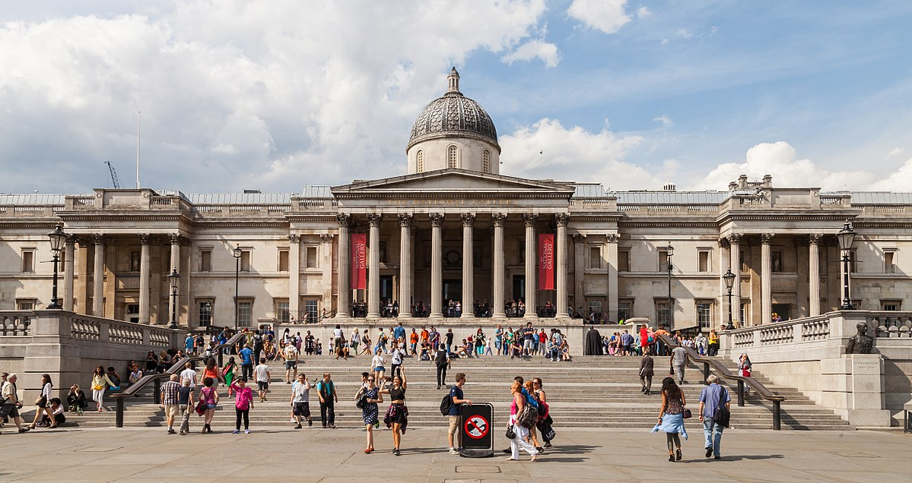
National Gallery
is an art gallery in which has one of the finest collections of European paintings in the world. These rare paintings include works by Leonardo, Giorgione, Michelangelo, Caravaggio, Vermeer, Rousseau and Redon.

Slide 9
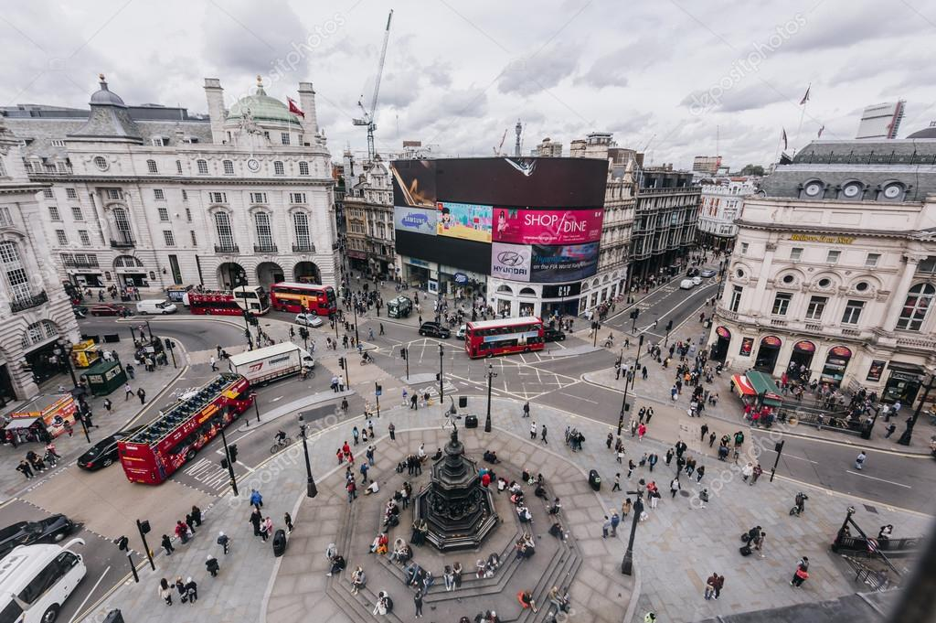
Piccadilly Circus
is a road junction (транспортний вузол, перехрестя) and public space of London's West End in the City of Westminster, built in 1819 to connect Regent Street with Piccadilly. A circus, from the Latin word meaning "circle", is a round open space at a street junction.

Slide 10
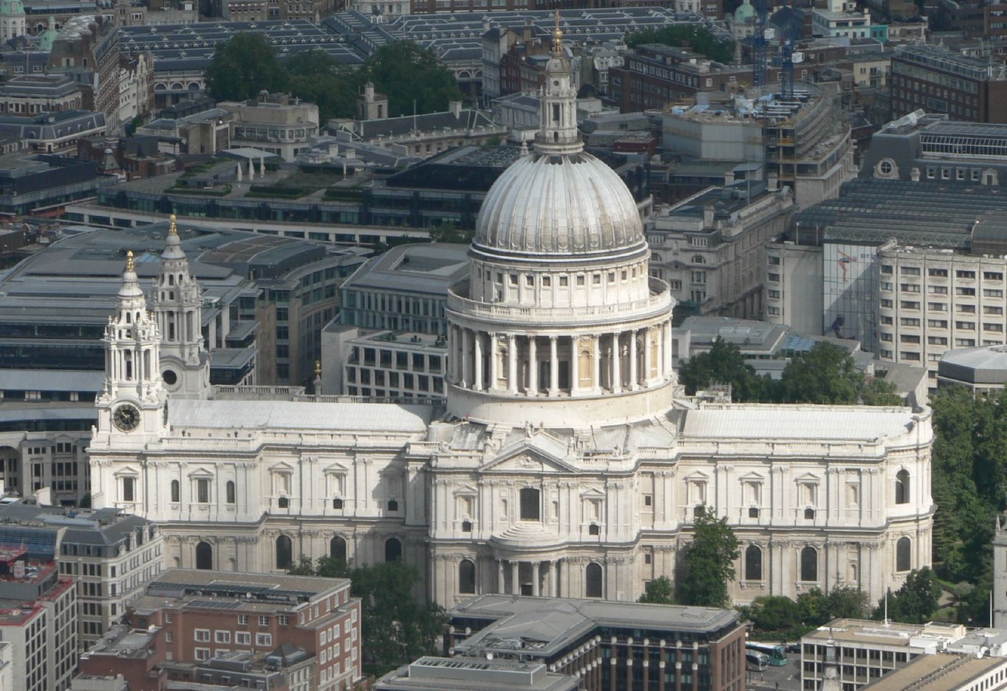
is an Anglican cathedral, was designed in the English Baroque style by Sir Christopher Wren. The wedding of Charles, Prince of Wales and Lady Diana Spencer was held there. You can see the memorial to Sir Christopher Wren there.
St Paul’s Cathedral

Slide 11
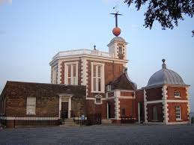
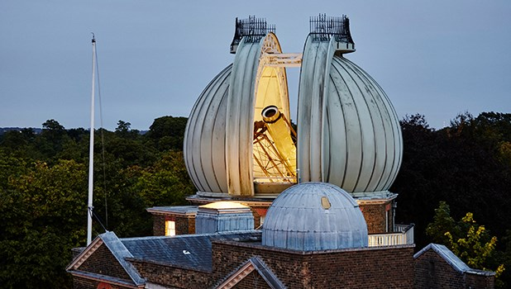
is an observatory situated on a hill in Greenwich Park. It played a major role in the history of astronomy and navigation, and is best known as the location of the prime meridian. You can look at the stars there.
The Royal Observatory (Greenwich)

Slide 12
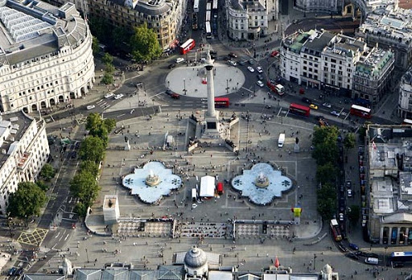
It is a large pedestrian square, bounded on three sides by roads. The National Art Gallery is one of several important buildings facing the square. It contains a large statue of Admiral Lord Nelson. Mainly, it is used for pleasure and relaxation, but sometimes there are meetings and demonstrations in Trafalgar Square.
Trafalgar Square

Slide 13
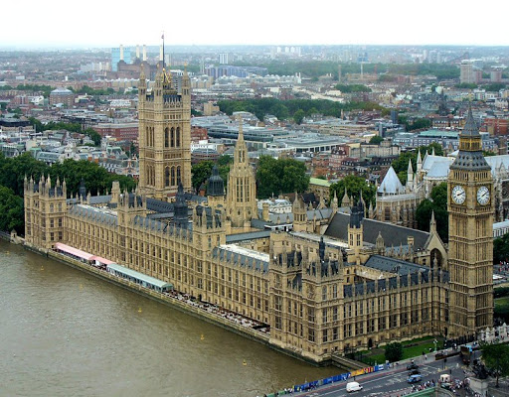
Westminster Palace
is the meeting place of the House of Commons and the House of Lords, the two houses of the Parliament of the United Kingdom. Commonly known as the Houses of Parliament after its occupants. At the north end of the Palace rises the most famous of the towers, Elizabeth Tower, commonly known as Big Ben.

Slide 14
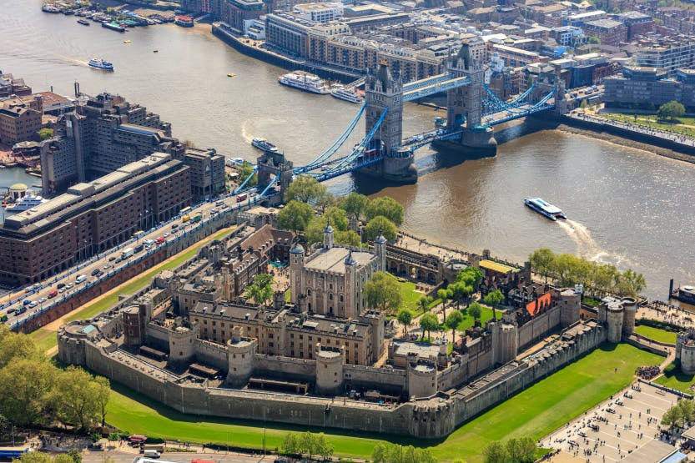
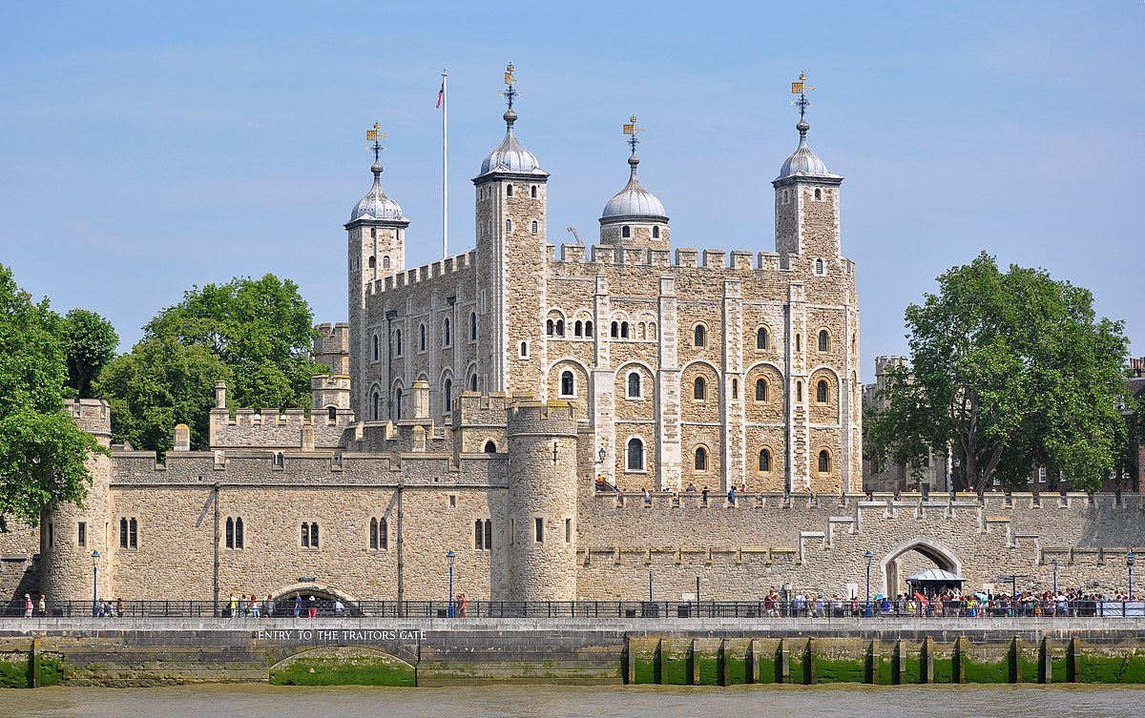
The Tower of London
officially Her Majesty's Royal Palace and Fortress of the Tower of London, is a historic castle located on the north bank of the River Thames in central London. It is the home of the Crown Jewels of England. The present collection of Crown Jewels contains various crowns, some of which are used by every Sovereign.

Slide 15
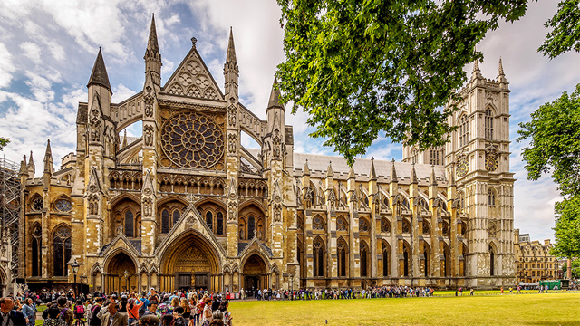
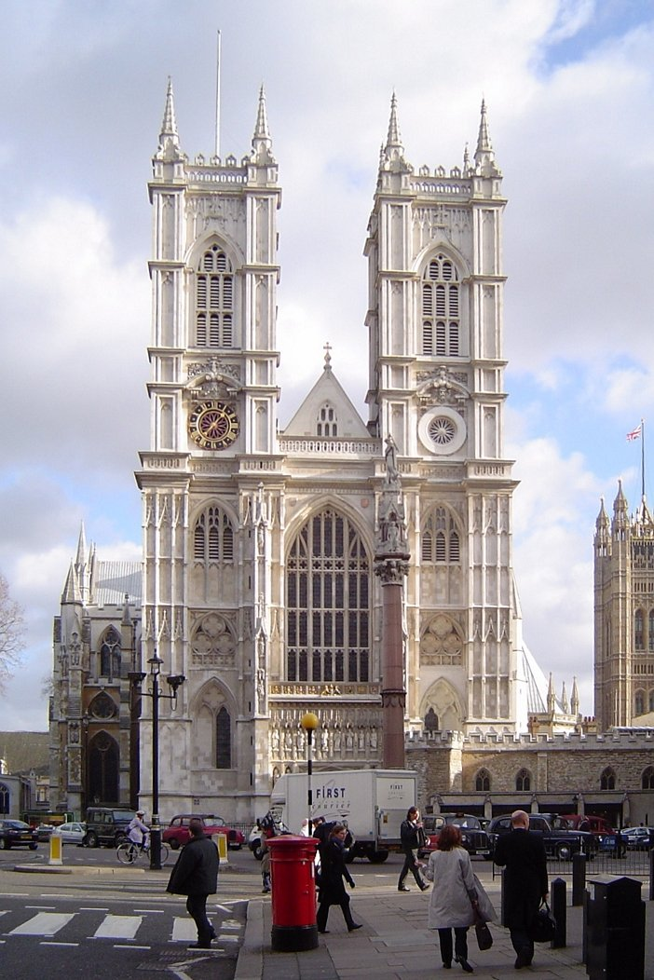
Westminster Abbey
formally titled the Collegiate Church of St Peter at Westminster, is a large, mainly Gothic abbey church. the traditional place of coronation and burial site for English and British monarchs.

Slide 16
See more
The British Museum https://kids.kiddle.co/British_Museum
Buckingham Palace https://kids.kiddle.co/Buckingham_Palace
Downing Street https://kids.kiddle.co/Downing_Street
London Eye https://kids.kiddle.co/London_Eye#:~:text=The%20London%20Eye%20is%20located,is%20Europe's%20tallest%20Ferris%20wheel.
Tower Bridge https://kids.kiddle.co/Tower_Bridge
Madame Tussauds https://kids.kiddle.co/Madame_Tussauds
National Gallery https://kids.kiddle.co/National_Gallery
Piccadilly Circus https://kids.kiddle.co/Piccadilly_Circus
St Paul’s Cathedral https://kids.kiddle.co/St_Paul%27s_Cathedral
The Royal Observatory (Greenwich) https://kids.kiddle.co/Royal_Observatory,_Greenwich
Trafalgar Square https://kids.kiddle.co/Trafalgar_Square
Westminster Palace https://kids.kiddle.co/Palace_of_Westminster
The Tower of London https://kids.kiddle.co/Tower_of_London
Westminster Abbey https://kids.kiddle.co/Westminster_Abbey

