Slide 1
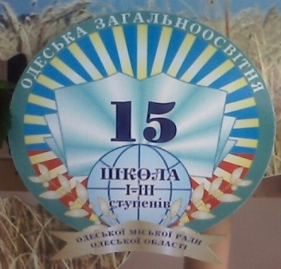
How do I get there?
Yevheniia Zahorska
School 15
Odesa, 2020

Slide 2
functions
Asking for and giving directions
Referring to the location of places in a city/town
Reading a map
structures
Prepositions of place
Prepositions of movement

Slide 3

Make up words from the letters and complete the poem.
Travelling
We go by ______ a, r, c
And we go by _________. i, t, n, a, r
We go by ______, a, t, b, o
We go by ______. n, e, l, a, p
We go by ______ d, a, l, n
And _____ and_______. a, s, e, i, r, a
We go, go, go
From here to there.
1
car
train
boat
2
plane
3
land
sea
air
5

Slide 4
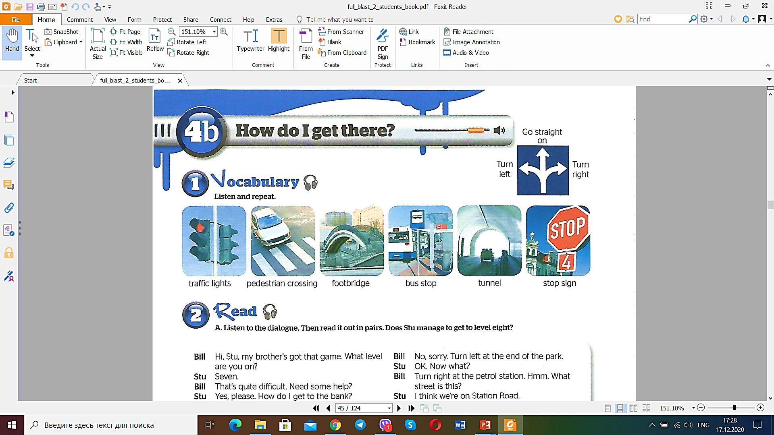

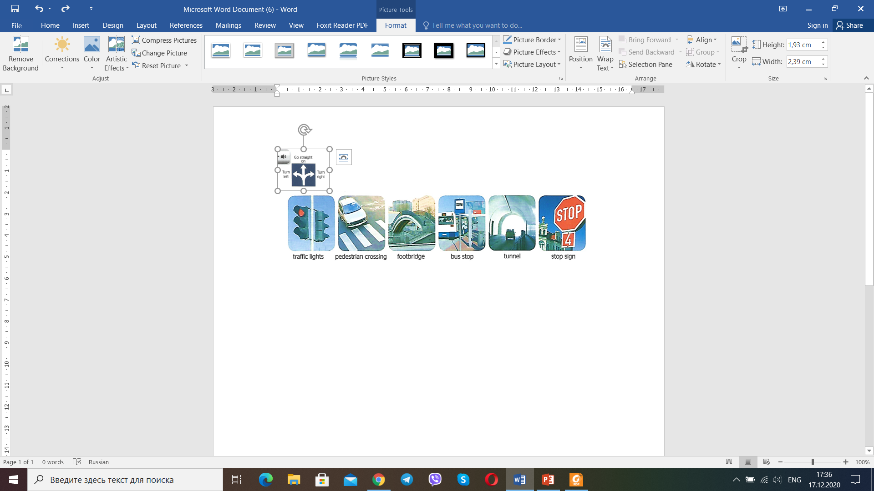
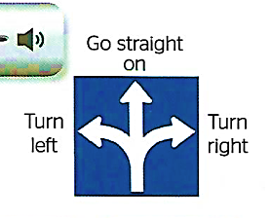
Vocabulary

Slide 5
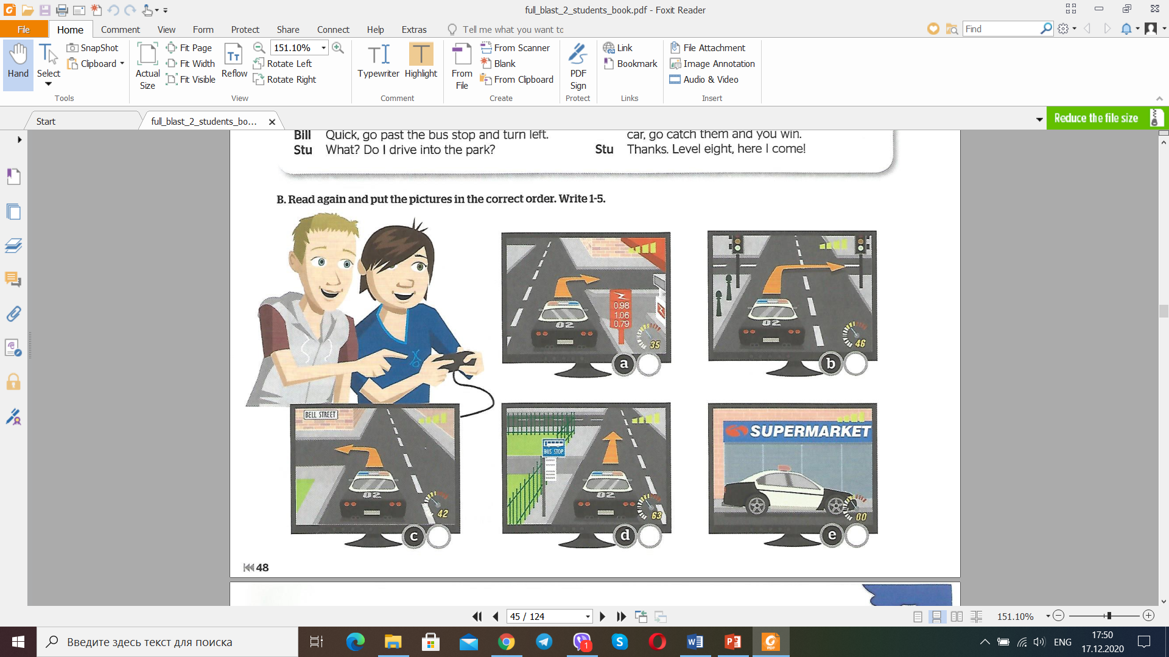
Look at the picture and tell me what is going on?
The boys are playing a computer game.

Slide 6
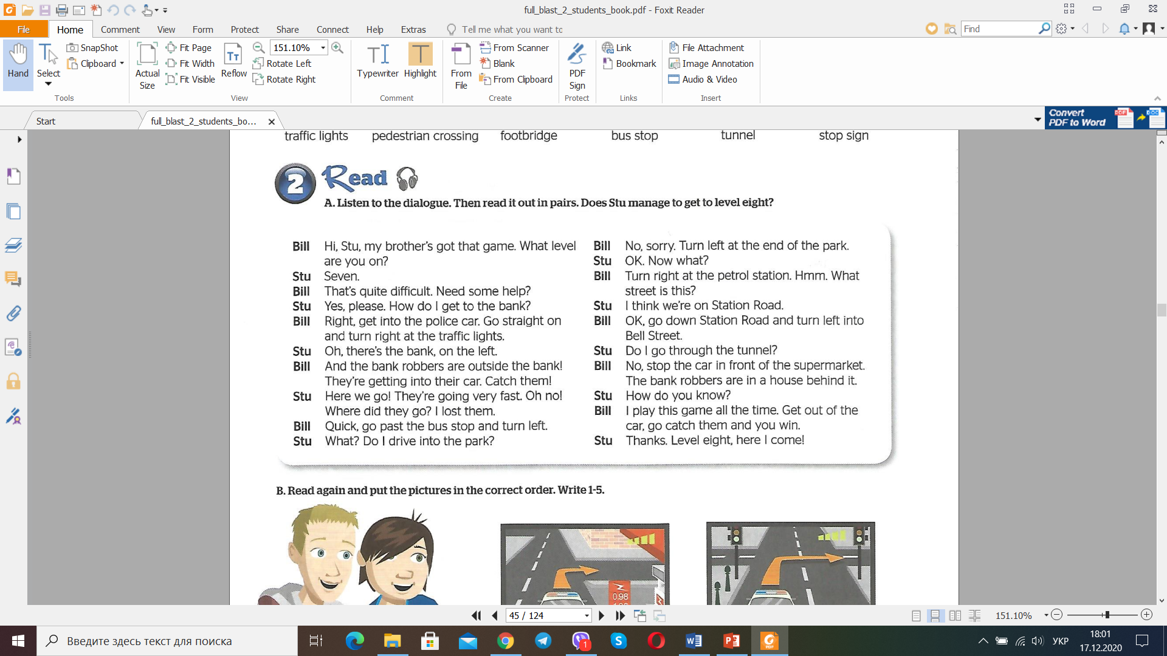
Listen to the dialogue. Then read it. Does Stu manage to get to level eight?

Slide 7
Read again and put the pictures in the correct order. Write 1-5.
3
1
4
2
5

Slide 8
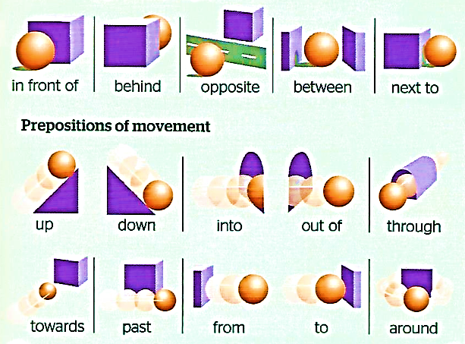
Grammar
Prepositions of place and movement
Prepositions of movement are used in combination with verbs denoting motion, such as walk, go, run, get, etc.

Slide 9
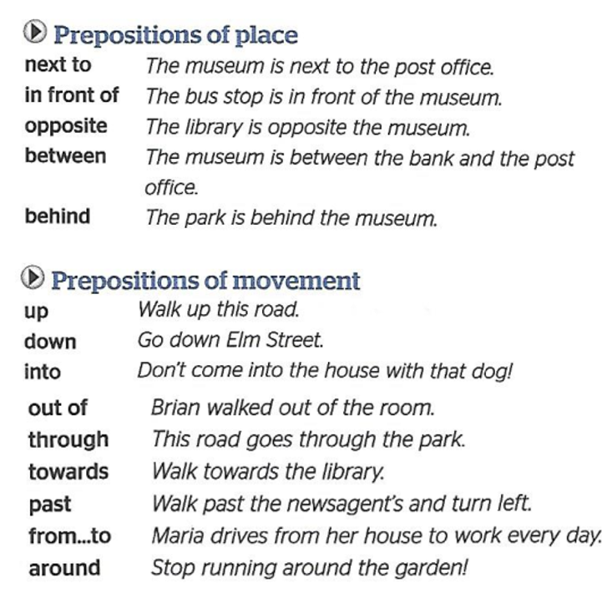
Grammar

Slide 10
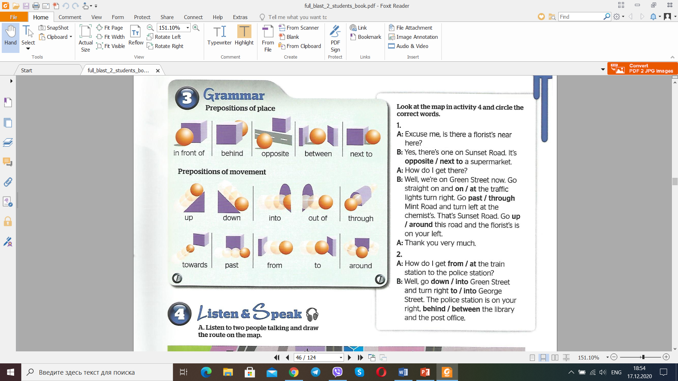
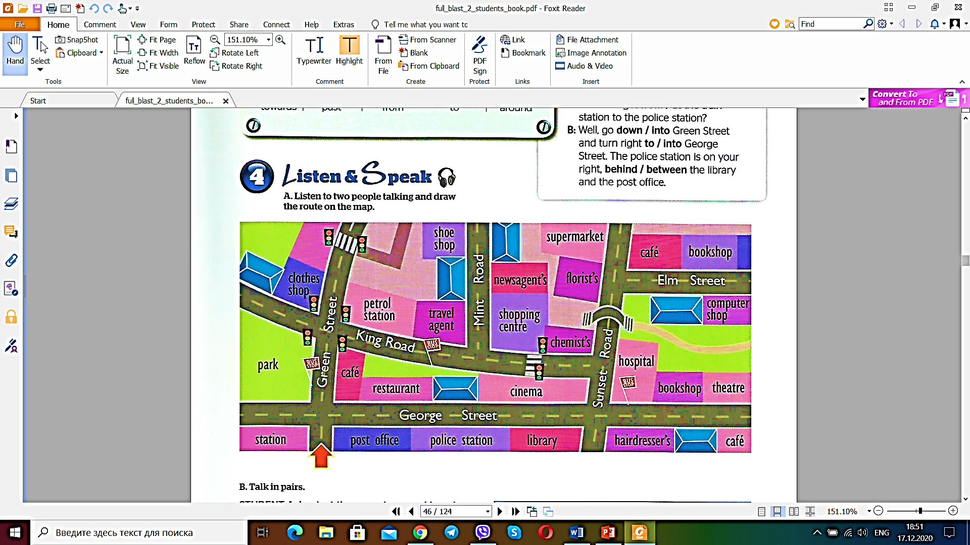
Look at the map and circle the correct words.

Slide 11
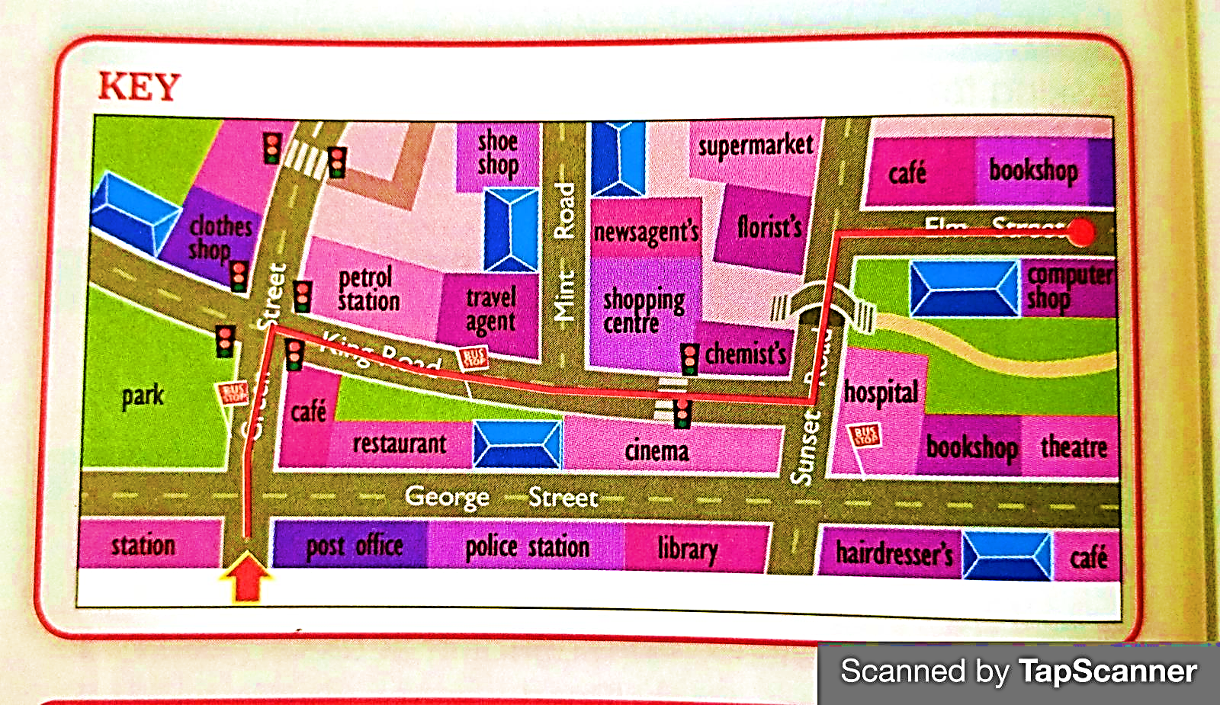
Listen to two people talking and draw the route on the map.

Slide 12
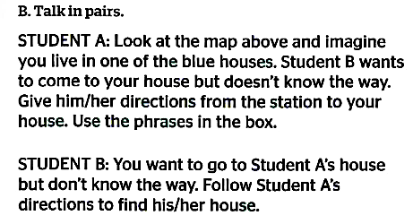
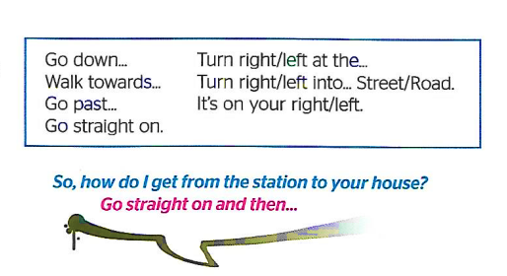
Homework

Slide 13

See you! Good luck!

