Slide 1
William Shakespeare
(1564 -1616)

Slide 2
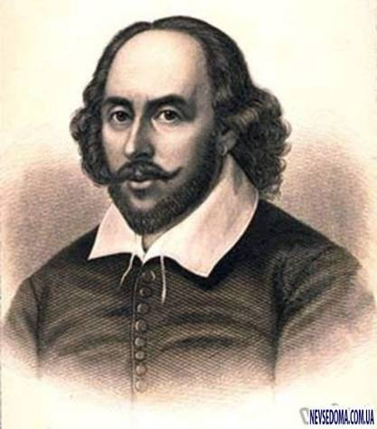
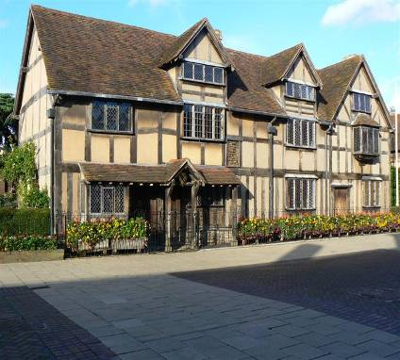
William Shakespeare was born on April, 23, 1564 in Stratford- on Avon

Slide 3
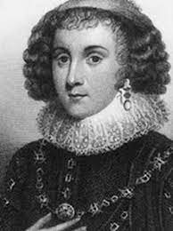
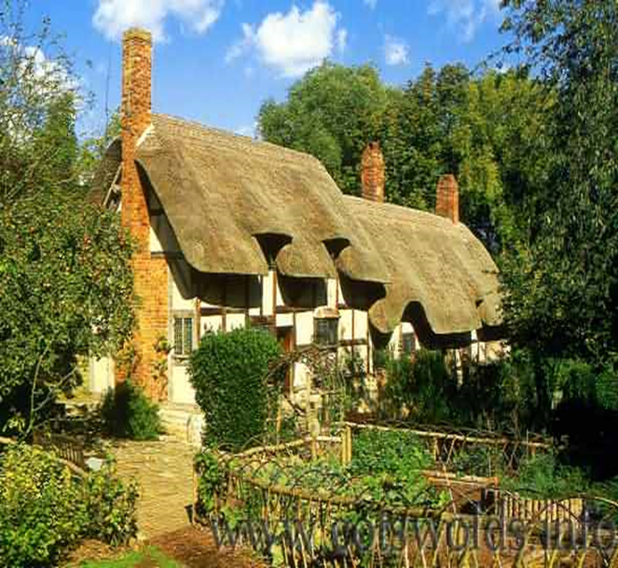
He marriages to Anne Hathaway, a daughter of a wealthy yeoman, in 1582. William was 18, Ann was 25

Slide 4
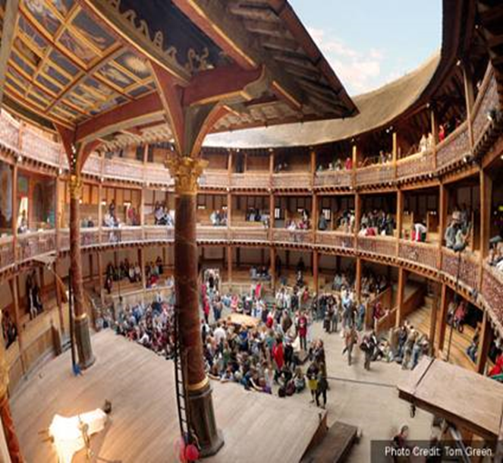
In 1592 Shakespeare had settled in London and in 1593 became a share-holder, the principal playwright and an actor of the Globe theatre on the southern bank of the Thames in London.

Slide 5
Shakespeare wrote lots of plays: comedies (plays with a happy end), tragedies (plays with the sad ending, often a story of murder), historical plays (patriotic play, often about the kings of England)

Slide 6
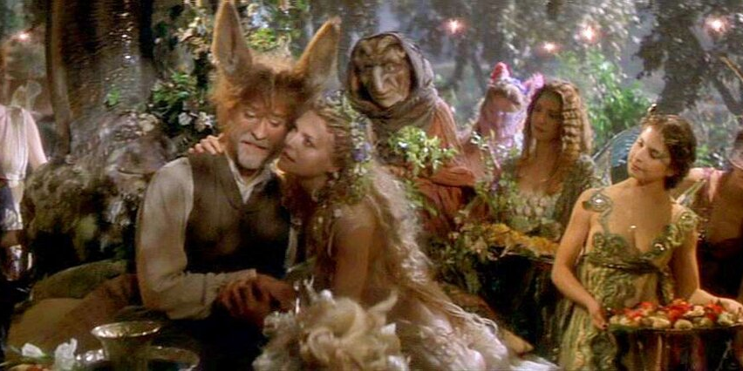
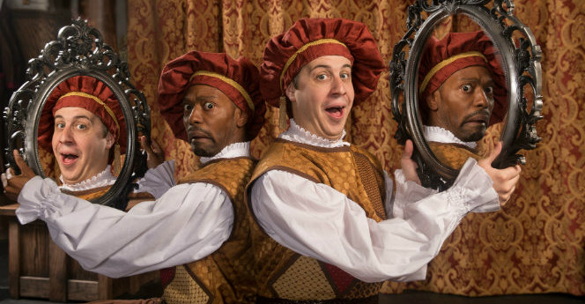
Comedies
A Midsummer Night’s Dream
The Comedy of Errors

Slide 7
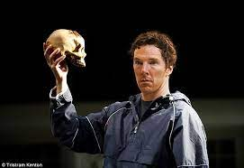
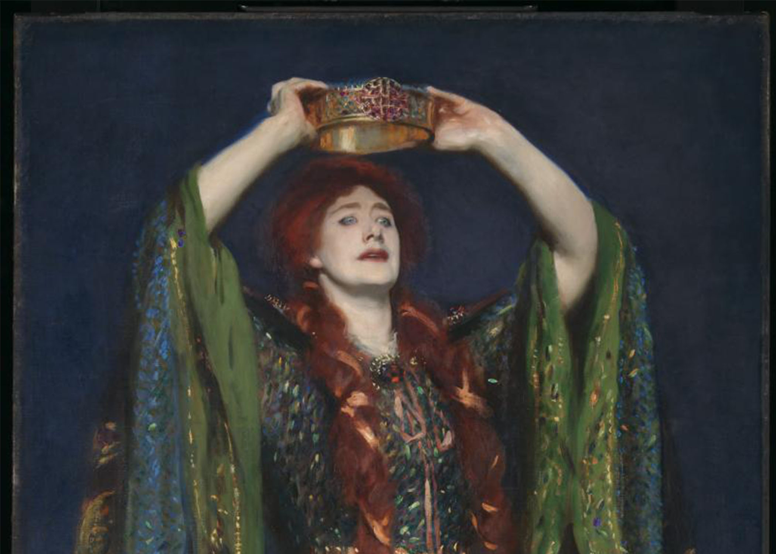
Tragedies
Hamlet
Macbeth

Slide 8
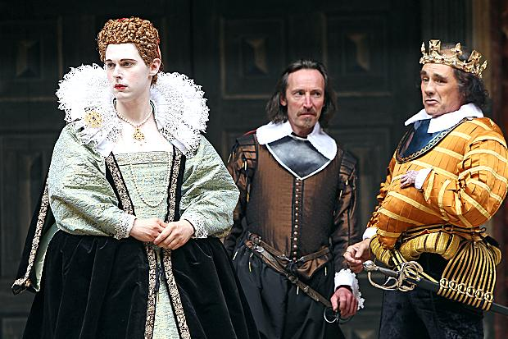
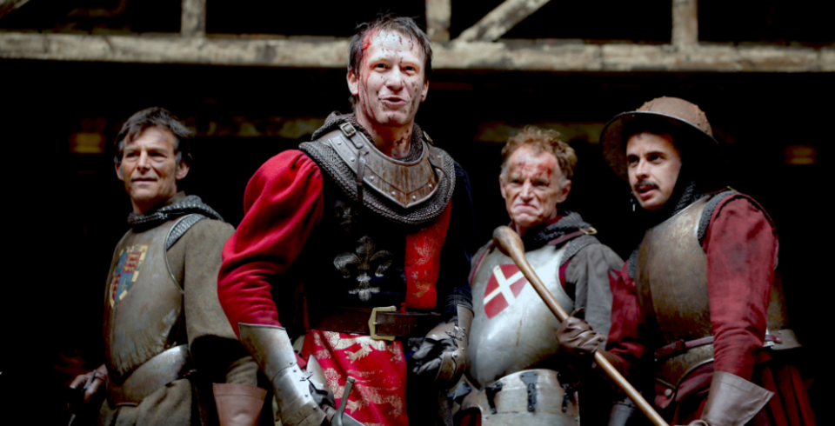
Historical plays
Richard III
Henry V

Slide 9
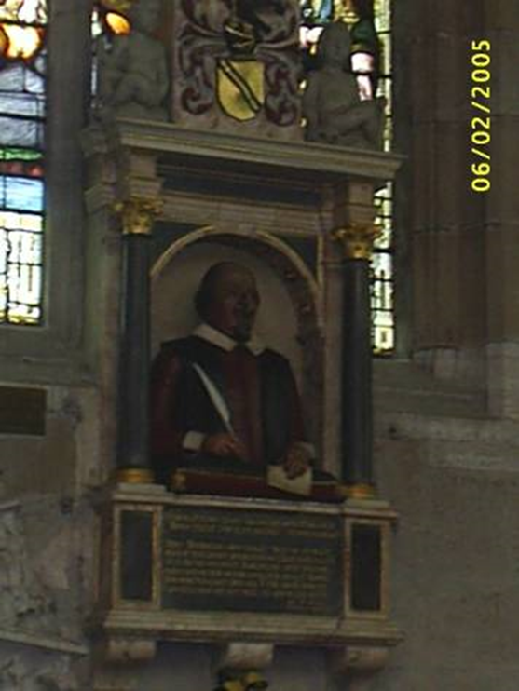
In 1613 after the Globe had been destroyed by fire, Shakespeare retired to Stratford where he died on April, 23, 1616. He was buried in the same Holy Trinity Church,

Slide 10
Thank you!

