Slide 1


Slide 2
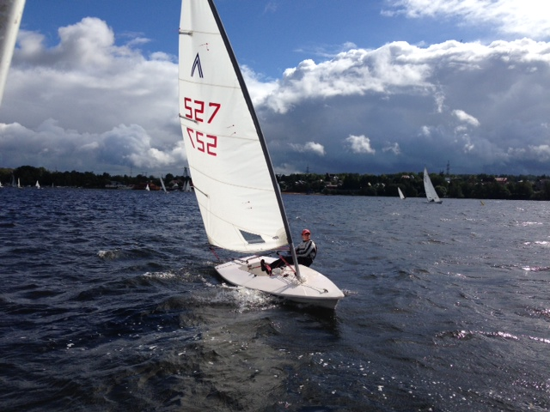
Sailing

Slide 3
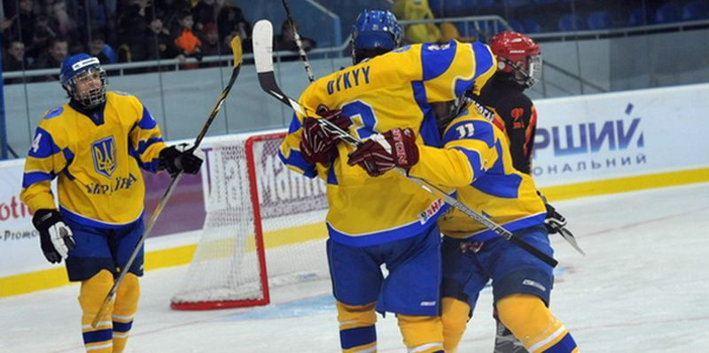
Hockey

Slide 4
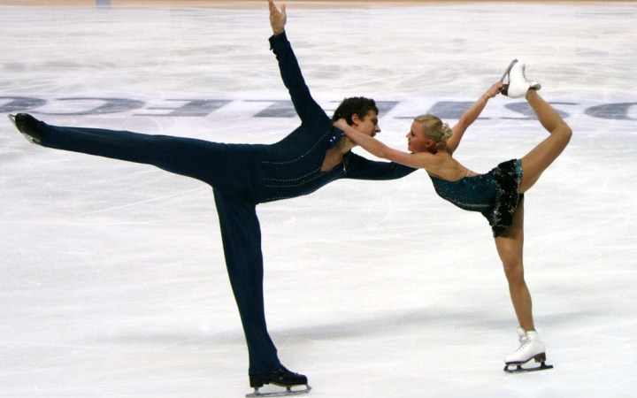
Skating

Slide 5
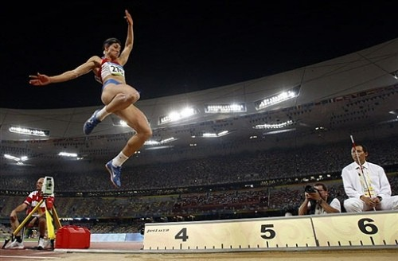
Long jump

Slide 6
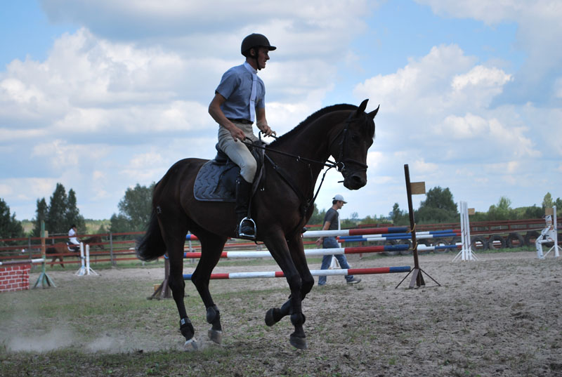
Horse riding

Slide 7
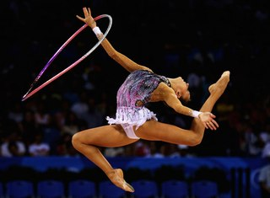
Gymnastics

Slide 8
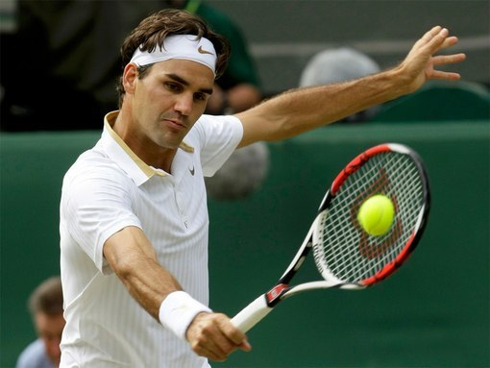
Tennis

Slide 9
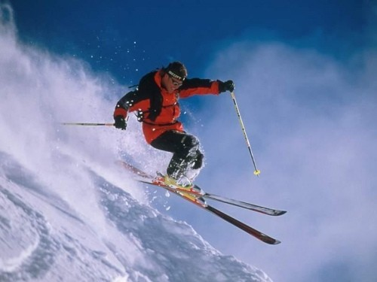
Skiing

Slide 10
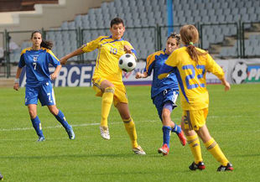
Football

Slide 11
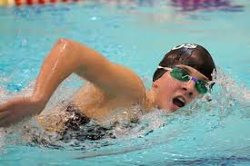
Swimming

Slide 12

Skateboarding

Slide 13
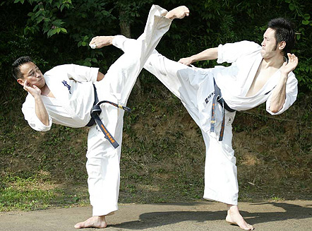
Karate

Slide 14
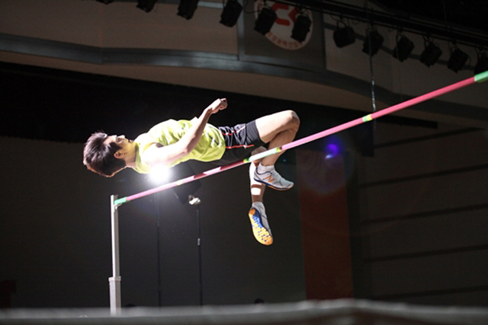
High jump

Slide 15

Running

Slide 16
Ok. Let’s talk!

Slide 17
DIALOGUE
A: DO YOU LIKE SPORT?
B:
A: WHAT IS YOUR FAVOURITE SPORT?
B:
A: REALLY? IT’S SO BORING.
B: ЯКИЙ ВИД СПОРТУ ТОБІ ПОДОБАЄТЬСЯ?
A:
B: МЕНІ ПОДОБАЄТЬСЯ АТЛЕТИКА ТАКОЖ.

Slide 18

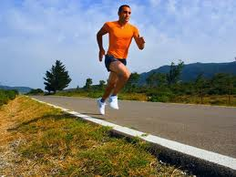
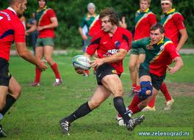
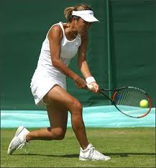
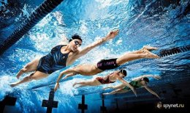
What national English sports do you know?
football
Running
Rugby
swimming
Tennis

Slide 19
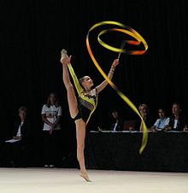
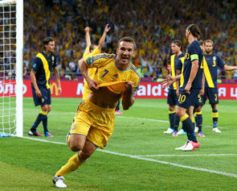
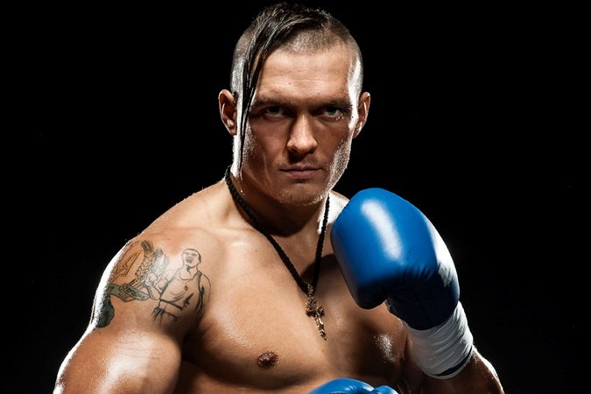
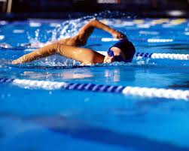
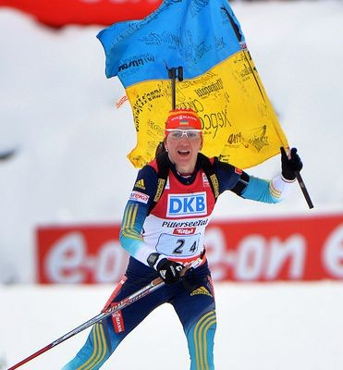
What sports are popular in Ukraine?
gymnastic
Football
boxing
Swimming
biathlon

Slide 20
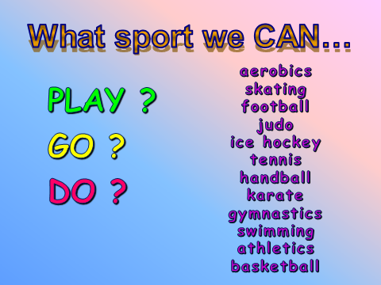

Slide 21
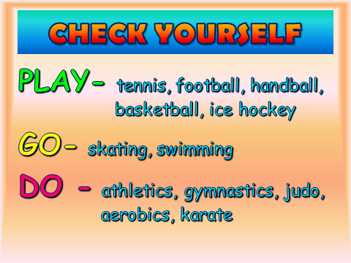

Slide 22
Name the kinds of sport
Indoor:
Outdoors:
Archery
Handball
Diving
Wrestling
Sailing
Volleyball
Football
Bowling
Surfing
Tennis
Biathlon

Slide 23
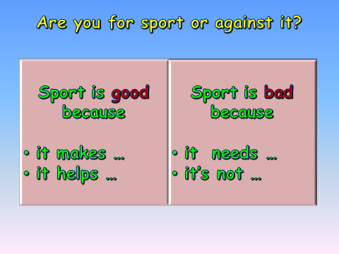

Slide 24

Дякую за співпрацю!
Ти молодець!

