Slide 1


Slide 2
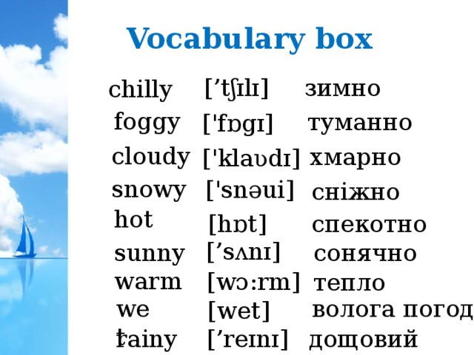

Slide 3
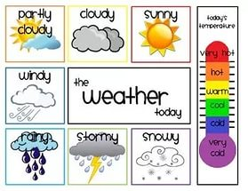

Slide 4
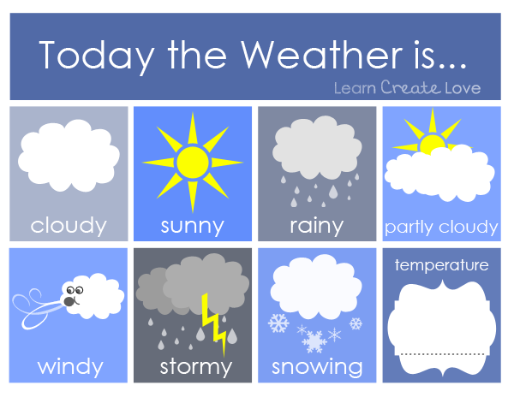
?
Next

Slide 5
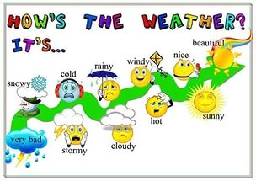

Slide 6
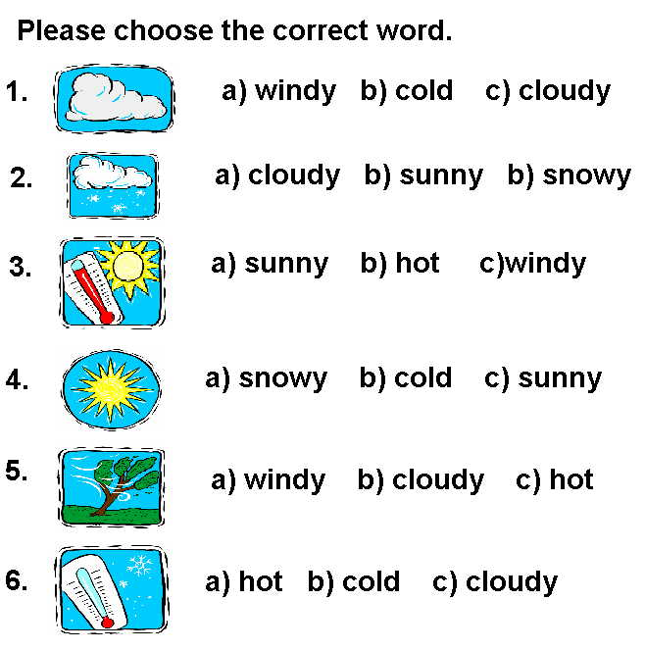
Cloudy
Snowy
Hot
Sunny
Windy
Cold
Next

Slide 7
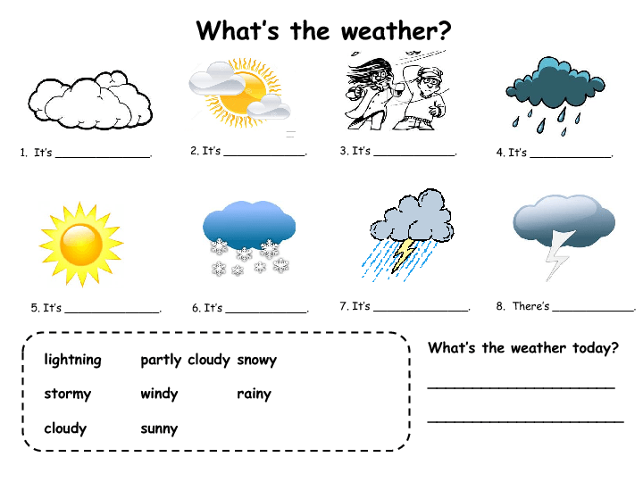
Write as many sentences as you can

Slide 8
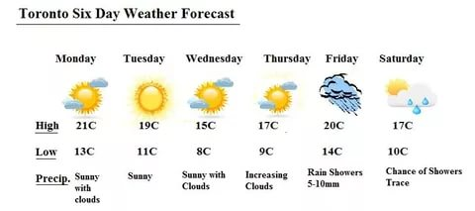

Slide 9
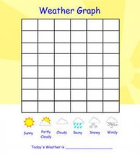
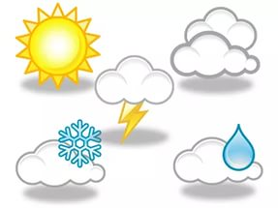
















Sun
+16+8
Mon
Tues
Wed
Thurs
Frid
Sat
Morning
Afternoon
Evening
Night
t

Slide 10
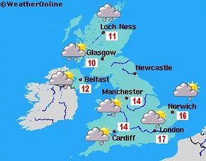

Slide 11
